Slide 1
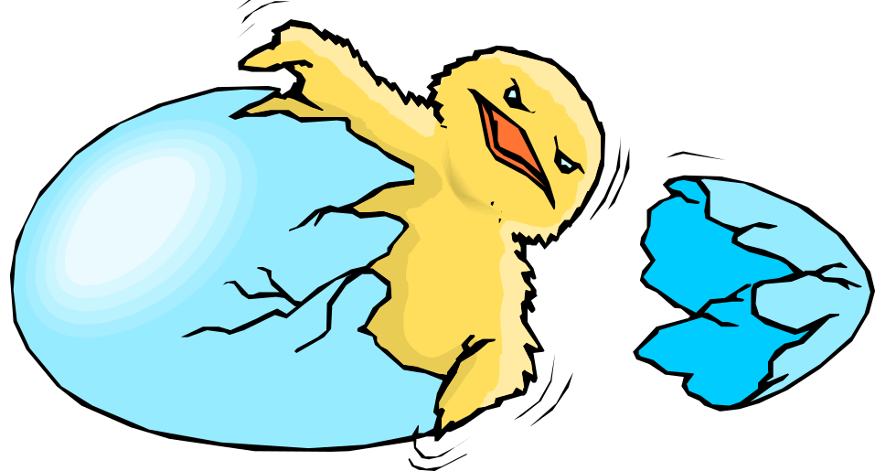
Attitude and Behavior
Dr J Balamurugan

Slide 2
Attitude
It is a disposition to approach an idea, event, person, or an object.
It is a tendency to act in one way or the another towards an ‘attitude object’ or something (i.e. idea, event, person, object, food, color, furniture, virtually everything).
Attitude is like a driver or decision maker. It decides how to act or behave in a particular situation.

Slide 3
Behaviour
Behaviour may be defined as
  The manner in which one behaves.
  The manner in which something functions or operates.
  The actions or reactions of a person or animal in response to external or internal stimuli.
  The response of an individual or group to it’s environment.

Slide 4
Types of Attitudes
Attitude may be positive or negative. If someone has good feelings about something e.g. towards his/her work, or people, then it is positive attitude otherwise it would be negative.
Attitudes can also be explicit and implicit. Explicit attitudes are those that we are consciously aware of and that clearly influence our behaviors and beliefs. Implicit attitudes are unconscious, but still have an effect on our beliefs and behaviors.

Slide 5
Positive attitude
The predisposition that results in desirable outcomes for individuals and organizations can be described as positive attitude.
Positive attitudes are rewarded.
It means the individual is encouraged to do the same thing in future.

Slide 6
Negative attitude
The tendency of a person that results in an undesirable outcome for individuals and organizations can be described as negative attitude.
Negative attitudes are punished in order to discourage the same action in future.

Slide 7
Formation of Attitudes
Imitation
Rewards and Punishments
Demonstration
Media (persuasive communications)

Slide 8
Formation of Attitudes
Imitation - Individual attitudes develop through the interaction of complex forces and are learnt.
We develop our attitudes from copying those people who are important to us (significant others), particularly parents and siblings.
Religious beliefs are good examples.

Slide 9
Formation of Attitudes
Rewards and punishments associated with certain actions make individuals acquire beliefs and accordingly result in building personal attitudes.

Slide 10
Formation of Attitudes
Demonstration effect from friends and playmates play an important role towards developing attitudes.

Slide 11
Formation of Attitudes
Media or persuasive communications also help develop certain attitudes.
Often our attitudes towards politics come from information or persuasive communications from media.

Slide 12
Change in Attitude
Attitude can be changed, if we differentiate negative attitude from positive attitude.
Positive attitude can bring positive change in life.
It is difficult to change attitudes but with some effort, it can be done.

Slide 13
Attitude Change
Learning Theory of Attitude Change:
Classical conditioning - Classical conditioning can be used to create positive emotional reactions to an object, person or event by associating positive feelings with the target object.
operant conditioning - Operant conditioning can be used to strengthen desirable attitudes and weaken undesirable ones.
observational learning - People can also change their attitudes after observing the behavior of others.

Slide 14

ABC’s model of Attitudes
Several components make up attitudes
Affect (emotion)
Behavior (actions)
Cognition (thoughts)

Slide 15
Tripartite (ABC) Model
Attitude object: Beer
Affective (emotions)
Emotion based e.g.
“Harmful-Beneficial”
“Relaxing-Stressful”
“Tasty-Bitter”
Cognitive (thoughts)
Belief based e.g.
“Beer kills my brain cells”
“Beer helps me to relax”
“Beer tastes good after a hard days work”
Behavioural (actions)
Intention based e.g.
“I will cut down on my beer drinking”
“I intend to drink beer when I’m stressed”
“I plan to drink more beer after work”

Slide 16
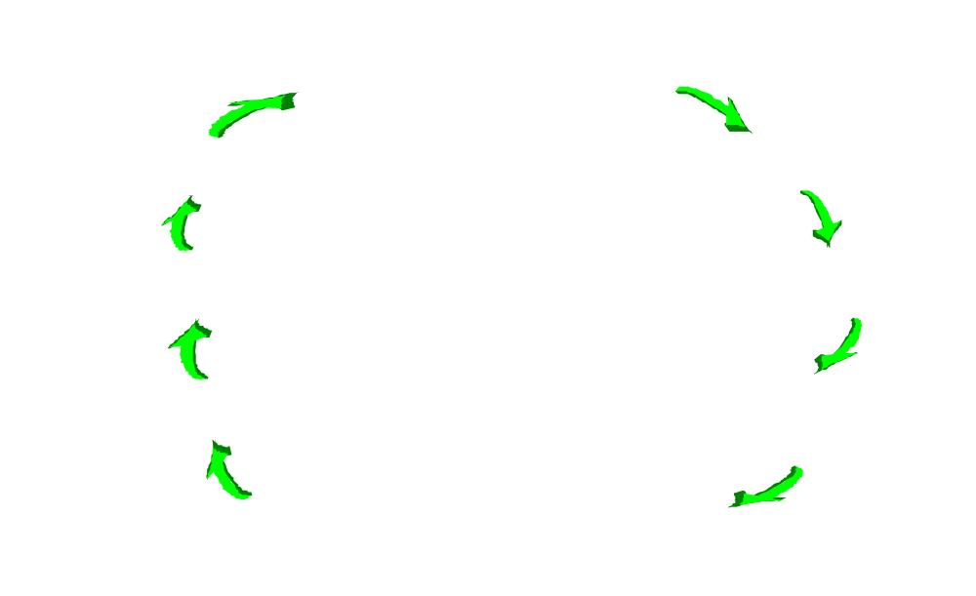
BETARI Box Model

Slide 17
Do Attitudes Determine Behavior?
An underlying assumption in persuasion research is: Shift a person’s attitude in the right direction and behavior will follow.
Examples:
If people think that smoking is bad for their health then they will quit.
If people see the value of wearing their seatbelt then they are more likely to actually wear it.

Slide 18
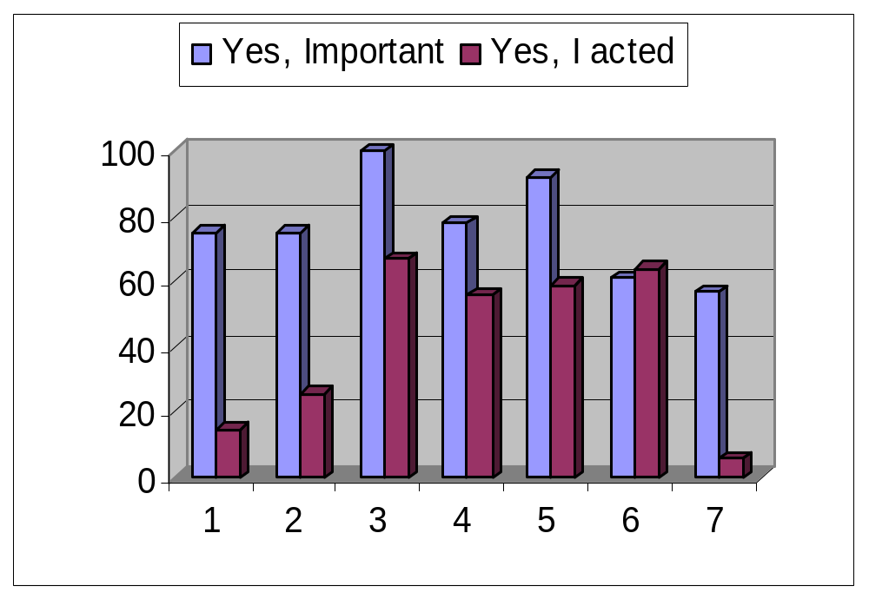
Attitude-Behavior Survey
Students should read
Homelessness is a problem
I should exercise
I should recycle
I should designate a driver
I should vote
Should change strategy to fight terrorism

Slide 19
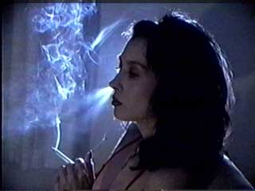
Do Attitudes determine Behavior? Yes, but not strongly.
Bottom Line examples!!!
  People often do things they know they shouldn’t.
  Smokers know smoking is harmful, but resist quitting.

Slide 20
Basic Questions
Is there a relationship between attitudes and behavior and, if so, how strong is it?

Slide 21
THANK YOU

